Slide 1

Creating Databases
and Tables

Slide 2
SQL
We’ve focused on querying and reading data from existing databases and tables.
Let’s now shift our focus to creating our own databases and tables.

Slide 3
SQL
Section Overview
Data Types
Primary and Foreign Keys
Constraints
CREATE
INSERT
UPDATE
DELETE, ALTER, DROP

Slide 4
SQL
We first focus on learning a few theoretical concepts, such as choosing the correct data type for a stored value and setting possible constraints on it.
We will also learn about primary and foreign keys.

Slide 5
Data Types

Slide 6
SQL
We’ve already encountered a variety of data types, let’s quickly review the main data types in SQL.

Slide 7
SQL
Boolean
True or False
Character
char, varchar, and text
Numeric
integer and floating-point number
Temporal
date, time, timestamp, and interval

Slide 8
SQL
UUID
Universally Unique Identifiers
Array
Stores an array of strings, numbers, etc.
JSON
Hstore key-value pair
Special types such as network address and geometric data.

Slide 9
SQL
When creating databases and tables, you should carefully consider which data types should be used for the data to be stored.
Review the documentation to see limitations of data types:
postgresql.org/docs/current/datatype.html

Slide 10
SQL
For example
Imagine we want to store a phone number, should it be stored as numeric?
If so, which type of numeric?
We could take a look at the documentation for options...

Slide 11
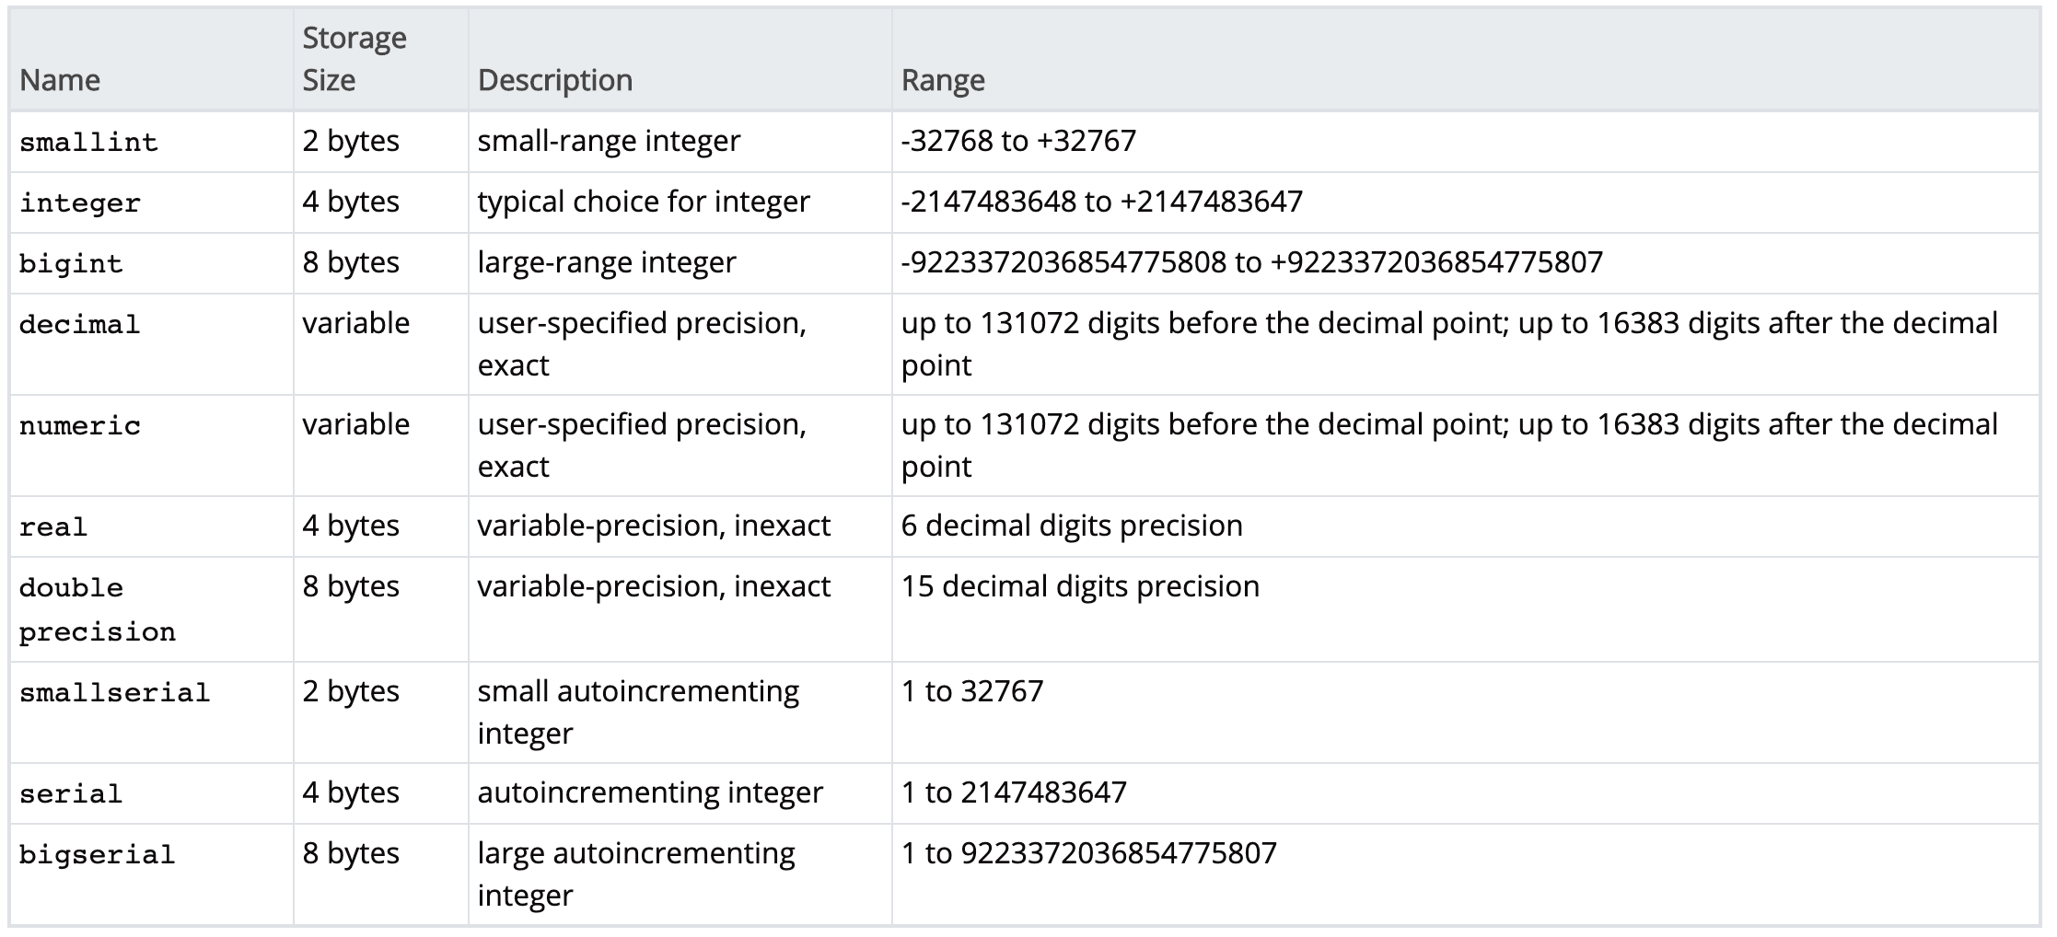
SQL
For example

Slide 12
SQL
Based on the limitations, you may think it makes sense to store it as a BIGINT data type, but we should really be thinking what is best for the situation.
Why bother with numerics at all?
We don’t perform arithmetic with numbers, so it probably makes more sense as a VARCHAR data type instead.

Slide 13
SQL
In fact, searching for best practice online, you will discover its usually recommended to store as a text based data type due to a variety of issues
No arithmetic performed
Leading zeros could cause issues, 7 and 07 treated same numerically, but are not the same phone number

Slide 14
SQL
When creating a database and table, take your time to plan for long term storage
Remember you can always remove historical information you’ve decided you aren’t using, but you can’t go back in time to add in information!

Slide 15
Primary and Foreign Keys

Slide 16
SQL
A primary key is a column or a group of columns used to identify a row uniquely in a table.
For example, in our dvdrental database we saw customers had a unique, non-null customer_id column as their primary key.

Slide 17
SQL
Primary keys are also important since they allow us to easily discern what columns should be used for joining tables together.

Slide 18
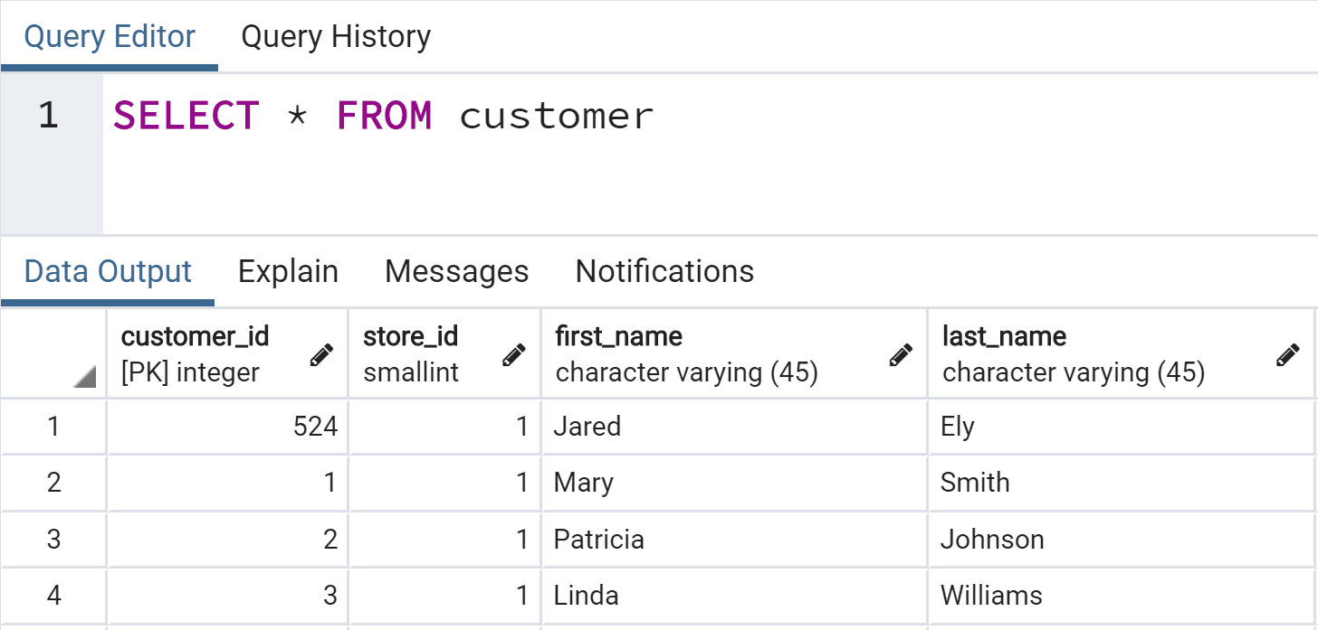
SQL
Example of Primary Key

Slide 19
SQL
Example of Primary Key

Slide 20
SQL
Notice its integer based and unique

Slide 21
SQL
Later we will learn about SERIAL data type

Slide 22
SQL
A foreign key is a field or group of fields in a table that uniquely identifies a row in another table.
A foreign key is defined in a table that references to the primary key of the other table.

Slide 23
SQL
The table that contains the foreign key is called referencing table or child table.
The table to which the foreign key references is called referenced table or parent table.
A table can have multiple foreign keys depending on its relationships with other tables.

Slide 24
SQL
Recall in the dvdrental database payment table, each payment row had its unique payment_id ( a primary key) and identified the customer that made the payment through the customer_id (a foreign key since it references the customer table’s primary key)

Slide 25
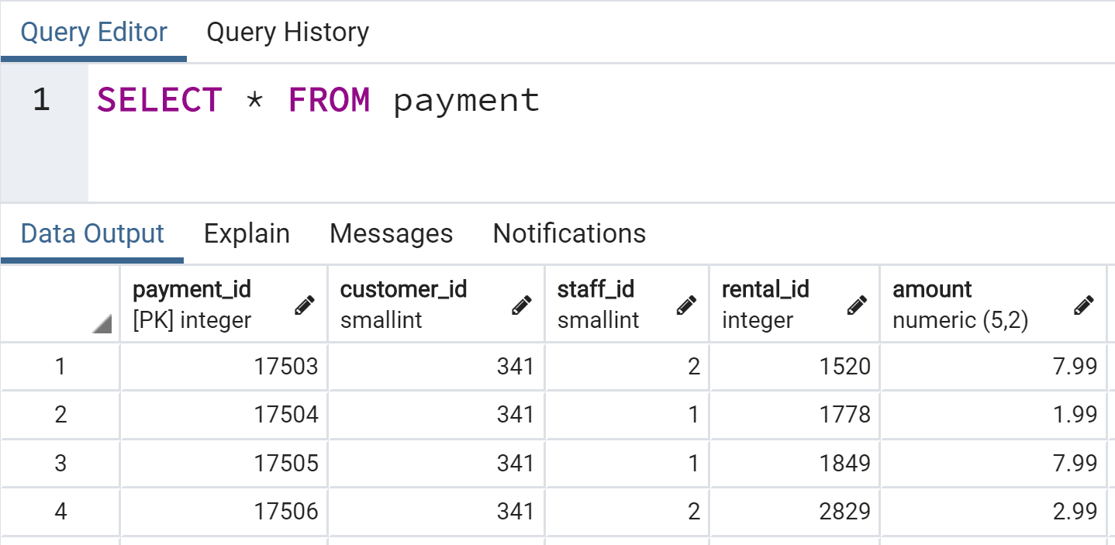
SQL
Example

Slide 26
SQL
Primary Key for Payment Table

Slide 27
SQL
Multiple Foreign Key References

Slide 28
SQL
Note pgAdmin won’t alert you to FK

Slide 29
SQL
You may begin to realize primary key and foreign key typically make good column choices for joining together two or more tables.

Slide 30
SQL
When creating tables and defining columns, we can use constraints to define columns as being a primary key, or attaching a foreign key relationship to another table.
Let’s quickly explore table properties in pgAdmin to see how to get information on primary and foreign keys!

Slide 31
Constraints

Slide 32
SQL
Constraints are the rules enforced on data columns on table.
These are used to prevent invalid data from being entered into the database.
This ensures the accuracy and reliability of the data in the database.

Slide 33
SQL
Constraints can be divided into two main categories:
Column Constraints
Constrains the data in a column to adhere to certain conditions.
Table Constraints
applied to the entire table rather than to an individual column.

Slide 34
SQL
The most common constraints used:
NOT NULL Constraint
Ensures that a column cannot have NULL value.
UNIQUE Constraint
Ensures that all values in a column are different.

Slide 35
SQL
The most common constraints used:
PRIMARY Key
Uniquely identifies each row/record in a database table.
FOREIGN Key
Constrains data based on columns in other tables.

Slide 36
SQL
The most common constraints used:
CHECK Constraint
Ensures that all values in a column satisfy certain conditions.

Slide 37
SQL
The most common constraints used:
EXCLUSION Constraint
Ensures that if any two rows are compared on the specified column or expression using the specified operator, not all of these comparisons will return TRUE.

Slide 38
SQL
Table Constraints
CHECK (condition)
to check a condition when inserting or updating data.
REFERENCES
to constrain the value stored in the column that must exist in a column in another table.

Slide 39
SQL
Table Constraints
UNIQUE (column_list)
forces the values stored in the columns listed inside the parentheses to be unique.
PRIMARY KEY(column_list)
Allows you to define the primary key that consists of multiple columns.

Slide 40
SQL
Now that we understand data types, primary keys, foreign keys, and constraints we are ready to begin using SQL syntax to create tables!

Slide 41
CREATE

Slide 42
SQL
Let’s now learn the syntax to create a table in SQL using the CREATE keyword and column syntax.

Slide 43
SQL
Full General Syntax
CREATE TABLE table_name (
column_name TYPE column_constraint,
column_name TYPE column_constraint,
table_constraint table_constraint
) INHERITS existing_table_name;

Slide 44
SQL
Full General Syntax
CREATE TABLE table_name (
column_name TYPE column_constraint,
column_name TYPE column_constraint,
table_constraint table_constraint
) INHERITS existing_table_name;

Slide 45
SQL
Full General Syntax
CREATE TABLE table_name (
column_name TYPE column_constraint,
column_name TYPE column_constraint,
table_constraint table_constraint
) INHERITS existing_table_name;

Slide 46
SQL
Full General Syntax
CREATE TABLE table_name (
column_name TYPE column_constraint,
column_name TYPE column_constraint,
table_constraint table_constraint
) INHERITS existing_table_name;

Slide 47
SQL
Full General Syntax
CREATE TABLE table_name (
column_name TYPE column_constraint,
column_name TYPE column_constraint,
table_constraint table_constraint
) INHERITS existing_table_name;

Slide 48
SQL
Full General Syntax
CREATE TABLE table_name (
column_name TYPE column_constraint,
column_name TYPE column_constraint,
table_constraint table_constraint
) INHERITS existing_table_name;

Slide 49
SQL
Full General Syntax
CREATE TABLE table_name (
column_name TYPE column_constraint,
column_name TYPE column_constraint,
table_constraint table_constraint
) INHERITS existing_table_name;

Slide 50
SQL
Common Simple Syntax
CREATE TABLE table_name (
column_name TYPE column_constraint,
column_name TYPE column_constraint,
);

Slide 51
SQL
Example Syntax
CREATE TABLE table_name (
column_name TYPE column_constraint,
column_name TYPE column_constraint,
);

Slide 52
SQL
Example Syntax
CREATE TABLE players(
column_name TYPE column_constraint,
column_name TYPE column_constraint,
);

Slide 53
SQL
Example Syntax
CREATE TABLE players(
column_name TYPE column_constraint,
column_name TYPE column_constraint,
);

Slide 54
SQL
Example Syntax
CREATE TABLE players(
column_name TYPE column_constraint,
column_name TYPE column_constraint,
);

Slide 55
SQL
Example Syntax
CREATE TABLE players(
player_id TYPE column_constraint,
column_name TYPE column_constraint,
);

Slide 56
SQL
Example Syntax
CREATE TABLE players(
player_id TYPE column_constraint,
column_name TYPE column_constraint,
);

Slide 57
SQL
Example Syntax
CREATE TABLE players(
player_id SERIAL column_constraint,
column_name TYPE column_constraint,
);

Slide 58
SQL
SERIAL
In PostgreSQL, a sequence is a special kind of database object that generates a sequence of integers.
A sequence is often used as the primary key column in a table.

Slide 59
SQL
SERIAL
It will create a sequence object and set the next value generated by the sequence as the default value for the column.
This is perfect for a primary key, because it logs unique integer entries for you automatically upon insertion.

Slide 60
SQL
SERIAL
If a row is later removed, the column with the SERIAL data type will not adjust, marking the fact that a row was removed from the sequence, for example
1,2,3,5,6,7
You know row 4 was removed at some point

Slide 61
SQL
SERIAL

Slide 62
SQL
SERIAL

Slide 63
SQL
Example Syntax
CREATE TABLE players(
player_id SERIAL column_constraint,
column_name TYPE column_constraint,
);

Slide 64
SQL
Example Syntax
CREATE TABLE players(
player_id SERIAL column_constraint,
column_name TYPE column_constraint,
);

Slide 65
SQL
Example Syntax
CREATE TABLE players(
player_id SERIAL PRIMARY KEY,
column_name TYPE column_constraint,
);

Slide 66
SQL
Example Syntax
CREATE TABLE players(
player_id SERIAL PRIMARY KEY,
column_name TYPE column_constraint,
);

Slide 67
SQL
Example Syntax
CREATE TABLE players(
player_id SERIAL PRIMARY KEY,
age TYPE column_constraint,
);

Slide 68
SQL
Example Syntax
CREATE TABLE players(
player_id SERIAL PRIMARY KEY,
age TYPE column_constraint,
);

Slide 69
SQL
For example

Slide 70
SQL
For example

Slide 71
SQL
Example Syntax
CREATE TABLE players(
player_id SERIAL PRIMARY KEY,
age TYPE column_constraint
);

Slide 72
SQL
Example Syntax
CREATE TABLE players(
player_id SERIAL PRIMARY KEY,
age SMALLINT column_constraint
);

Slide 73
SQL
Example Syntax
CREATE TABLE players(
player_id SERIAL PRIMARY KEY,
age SMALLINT column_constraint
);

Slide 74
SQL
Example Syntax
CREATE TABLE players(
player_id SERIAL PRIMARY KEY,
age SMALLINT NOT NULL
);

Slide 75
SQL
Example Syntax
CREATE TABLE players(
player_id SERIAL PRIMARY KEY,
age SMALLINT NOT NULL
);

Slide 76
SQL
Let’s explore some examples in pgAdmin!

Slide 77
INSERT

Slide 78
SQL
INSERT allows you to add in rows to a table.
General Syntax
INSERT INTO table (column1, column2, …)
VALUES
(value1, value2, …),
(value1, value2, …) ,...;

Slide 79
SQL
INSERT allows you to add in rows to a table.
Syntax for Inserting Values from another table:
INSERT INTO table(column1,column2,...)
SELECT column1,column2,...
FROM another_table
WHERE condition;

Slide 80
SQL
Keep in mind, the inserted row values must match up for the table, including constraints.
SERIAL columns do not need to be provided a value.
Let’s use INSERT in pgAdmin!

Slide 81
UPDATE

Slide 82
SQL
The UPDATE keyword allows for the changing of values of the columns in a table.

Slide 83
SQL
General Syntax
UPDATE table
SET column1 = value1,
column2 = value2 ,...
WHERE
condition;

Slide 84
SQL
Example
UPDATE account
SET last_login = CURRENT_TIMESTAMP
WHERE last_login IS NULL;

Slide 85
SQL
Reset everything without WHERE condition
UPDATE account
SET last_login = CURRENT_TIMESTAMP

Slide 86
SQL
Set based on another column
UPDATE account
SET last_login = created_on

Slide 87
SQL
Using another table’s values (UPDATE join)
UPDATE TableA
SET original_col = TableB.new_col
FROM tableB
WHERE tableA.id = TableB.id

Slide 88
SQL
Return affected rows
UPDATE account
SET last_login = created_on
RETURNING account_id,last_login

Slide 89
SQL
Let’s explore this further in pgAdmin!

Slide 90
DELETE

Slide 91
SQL
We can use the DELETE clause to remove rows from a table.
For example:
DELETE FROM table
WHERE row_id = 1

Slide 92
SQL
We can delete rows based on their presence in other tables
For example:
DELETE FROM tableA
USING tableB
WHERE tableA.id=TableB.id

Slide 93
SQL
We can delete all rows from a table
For example:
DELETE FROM table

Slide 94
SQL
Similar to UPDATE command, you can also add in a RETURNING call to return rows that were removed.
Let’s explore DELETE with pgAdmin!

Slide 95
ALTER

Slide 96
SQL
The ALTER clause allows for changes to an existing table structure, such as:
Adding,dropping,or renaming columns
Changing a column’s data type
Set DEFAULT values for a column
Add CHECK constraints
Rename table

Slide 97
SQL
General Syntax
ALTER TABLE table_name action

Slide 98
SQL
Adding Columns
ALTER TABLE table_name
ADD COLUMN new_col TYPE

Slide 99
SQL
Removing Columns
ALTER TABLE table_name
DROP COLUMN col_name

Slide 100
SQL
Alter constraints
ALTER TABLE table_name
ALTER COLUMN col_name
SET DEFAULT value

Slide 101
SQL
Alter constraints
ALTER TABLE table_name
ALTER COLUMN col_name
DROP DEFAULT

Slide 102
SQL
Alter constraints
ALTER TABLE table_name
ALTER COLUMN col_name
SET NOT NULL

Slide 103
SQL
Alter constraints
ALTER TABLE table_name
ALTER COLUMN col_name
DROP NOT NULL

Slide 104
SQL
Alter constraints
ALTER TABLE table_name
ALTER COLUMN col_name
ADD CONSTRAINT constraint_name

Slide 105
SQL
Let’s explore some examples in pgAdmin!

Slide 106
DROP

Slide 107
SQL
DROP allows for the complete removal of a column in a table.
In PostgreSQL this will also automatically remove all of its indexes and constraints involving the column.
However, it will not remove columns used in views, triggers, or stored procedures without the additional CASCADE clause.

Slide 108
SQL
General Syntax
ALTER TABLE table_name
DROP COLUMN col_name

Slide 109
SQL
Remove all dependencies
ALTER TABLE table_name
DROP COLUMN col_name CASCADE

Slide 110
SQL
Check for existence to avoid error
ALTER TABLE table_name
DROP COLUMN IF EXISTS col_name

Slide 111
SQL
Drop multiple columns
ALTER TABLE table_name
DROP COLUMN col_one,
DROP COLUMN col_two

Slide 112
SQL
Let’s see a quick example in pgAdmin!

Slide 113
CHECK

Slide 114
SQL
The CHECK constraint allows us to create more customized constraints that adhere to a certain condition.
Such as making sure all inserted integer values fall below a certain threshold.

Slide 115
SQL
General Syntax
CREATE TABLE example(
ex_id SERIAL PRIMARY KEY,
age SMALLINT CHECK (age > 21),
parent_age SMALLINT CHECK ( parent_age > age)
);

Slide 116
SQL
Let’s explore this concept in pgAdmin!

